Slide 1



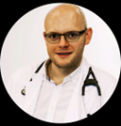
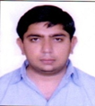
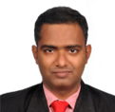

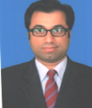
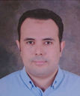
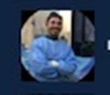
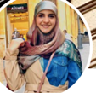


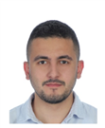
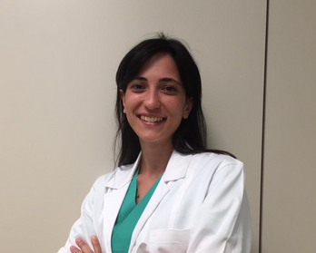

Bernardo Cortese, MD, FESC, FSCAI
President, Scientific Committee Fondazione RIC
Director, DCB Academy
www.fondazioneric.org
Fellows DCB Academy
Sara Malakouti
Physician and Researcher
Wojciech Wańha
Cardiologist
Munjal Amit Sushil
Cardiologist
Jegan Sivalingam
Cardiologist
Sylwia Iwanczyk
Cardiologist
Mazhar Jamail Qureshi
Cardiologist
Khaled Hamada
Cardiologist
Leontin Lazar
Cardiologist
Rima Chaddad
Cardiologist
Jacinthe Khater
Medical Student
Sandeep Basavarajaiah
Cardiologist
Antoine El Khoury
Cardiologist
Alessandra Laricchia
Cardiologist
Krupal Reddy
Cardiologist

