Slide 1
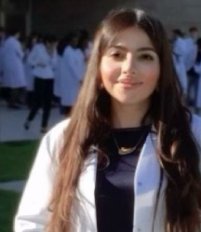
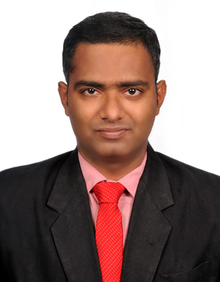
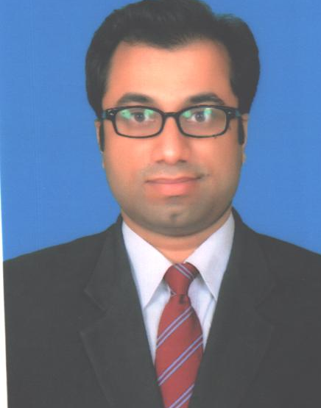
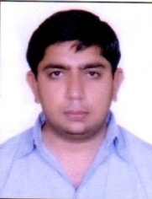
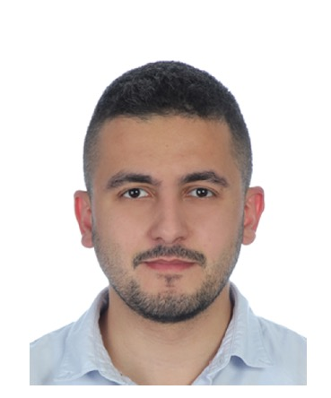
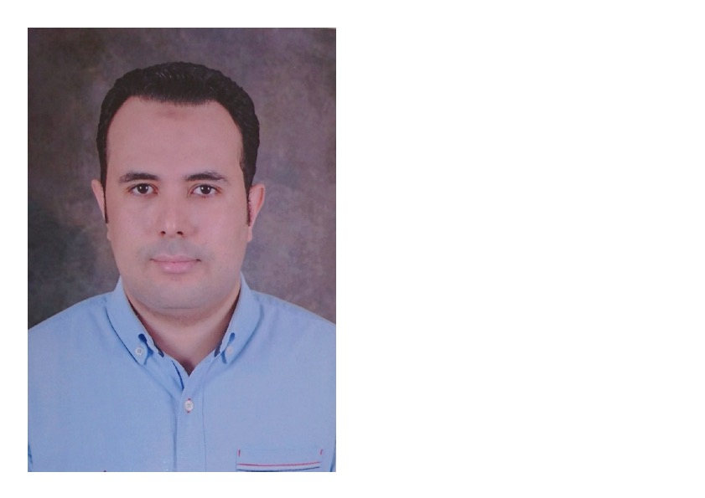
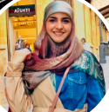
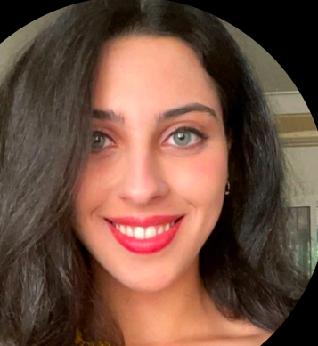
Fellowship’s Research Activities 2022-2023 recognized by:
Fondazione e Ricerca Innovazione Cardiovascolare
Bernardo Cortese, MD, FESC
President, Scientific Committee Fondazione RIC
Director, DCB ACADEMY
We are happy to announce, a new activity by DCB Academy:
2022-2023
Scientific Fellowship Program
Dr. Sara Malakouti from Iran
Physician and Researcher
Dr. Jegan Sivalingam from India
Interventional Cardiologist
Dr. Mazhar Jamail Qureshi from Pakistan
Cardiologist
Dr. Munjal Amit Sushil from India
Cardiologist
Dr. Antoine El Khoury from Lebanon
Cardiologist
Dr. Khaled Hamada from Egypt
Cardiologist
Dr. Jacinthe Khater from Lebanon
Medical Student
Dr. Rima Chaddad from Lebanon
Cardiologist

